Slide 1
Cardinality of Sets
Computer Science, Purdue University
Copyright McGraw Hill, Rosen, Discrete Mathematics and its Applications

Slide 2
Cardinality of Sets
Cardinality Revisited
Definition: The cardinality of a set A is equal to the cardinality of a set B, denoted
|A| = |B|,
if and only if there is a one-to-one correspondence (i.e., a bijection) from A to B.
If there is a one-to-one function (i.e., an injection) from A to B, the cardinality of A is less than or the same as the cardinality of B and we write |A| ≤ |B|.
When |A| ≤ |B| and A and B have different cardinality, we say that the cardinality of A is less than the cardinality of B and write |A| < |B|.
Computer Science, Purdue University

Slide 3
Cardinality of Sets
Cardinality Revisited
Definition: A set that is either finite or has the same cardinality as the set of positive integers (Z⁺) is called countable. A set that is not countable is uncountable.
The set of real numbers R is an uncountable set.
When an infinite set is countable (countably infinite), its cardinality is ℵ₀ (where ℵ is aleph, the 1st letter of the Hebrew alphabet). We write |S| = ℵ₀ and say that S has cardinality “aleph null.”
Computer Science, Purdue University

Slide 4
Cardinality of Sets
Showing that a Set is Countable
An infinite set is countable if and only if it is possible to list the elements of the set in a sequence (indexed by the positive integers).
The reason for this is that a one-to-one correspondence f from the set of positive integers to a set S can be expressed in terms of a sequence a₁,a₂,…, a_{n} ,… where a₁ = f(1), a₂ = f(2),…, a_{n} = f(n),…
Computer Science, Purdue University

Slide 5
Cardinality of Sets
Showing that a Set is Countable
Example 1: Show that the set of positive even integers E is countable set.
Solution: Let f(x) = 2x.
1 2 3 4 5 6 …..
2 4 6 8 10 12 ……
Then f is a bijection from N to E since f is both one-to-one and onto. To show that it is one-to-one, suppose that f(n) = f(m). Then 2n = 2m, and so n = m. To see that it is onto, suppose that t is an even positive integer. Then t = 2k for some positive integer k and f(k) = t.
Computer Science, Purdue University

Slide 6
Cardinality of Sets
Showing that a Set is Countable
Example 2: Show that the set of integers Z is countable.
Solution: Can list in a sequence:
0, 1, − 1, 2, − 2, 3, − 3 ,………..
Or can define a bijection from N to Z:
When n is even: f(n) = n/2
When n is odd: f(n) = −(n−1)/2
Computer Science, Purdue University

Slide 7
Cardinality of Sets
The Set of Rational Numbers is Countable
Definition: A rational number can be expressed as the ratio of two integers p and q such that q ≠ 0.
¾ is a rational number
√2 is not a rational number.
Example 3: Show that the positive rational numbers are countable.
Solution:The positive rational numbers are countable since they can be arranged in a sequence:
r₁ , r₂ , r₃ ,…
Computer Science, Purdue University

Slide 8
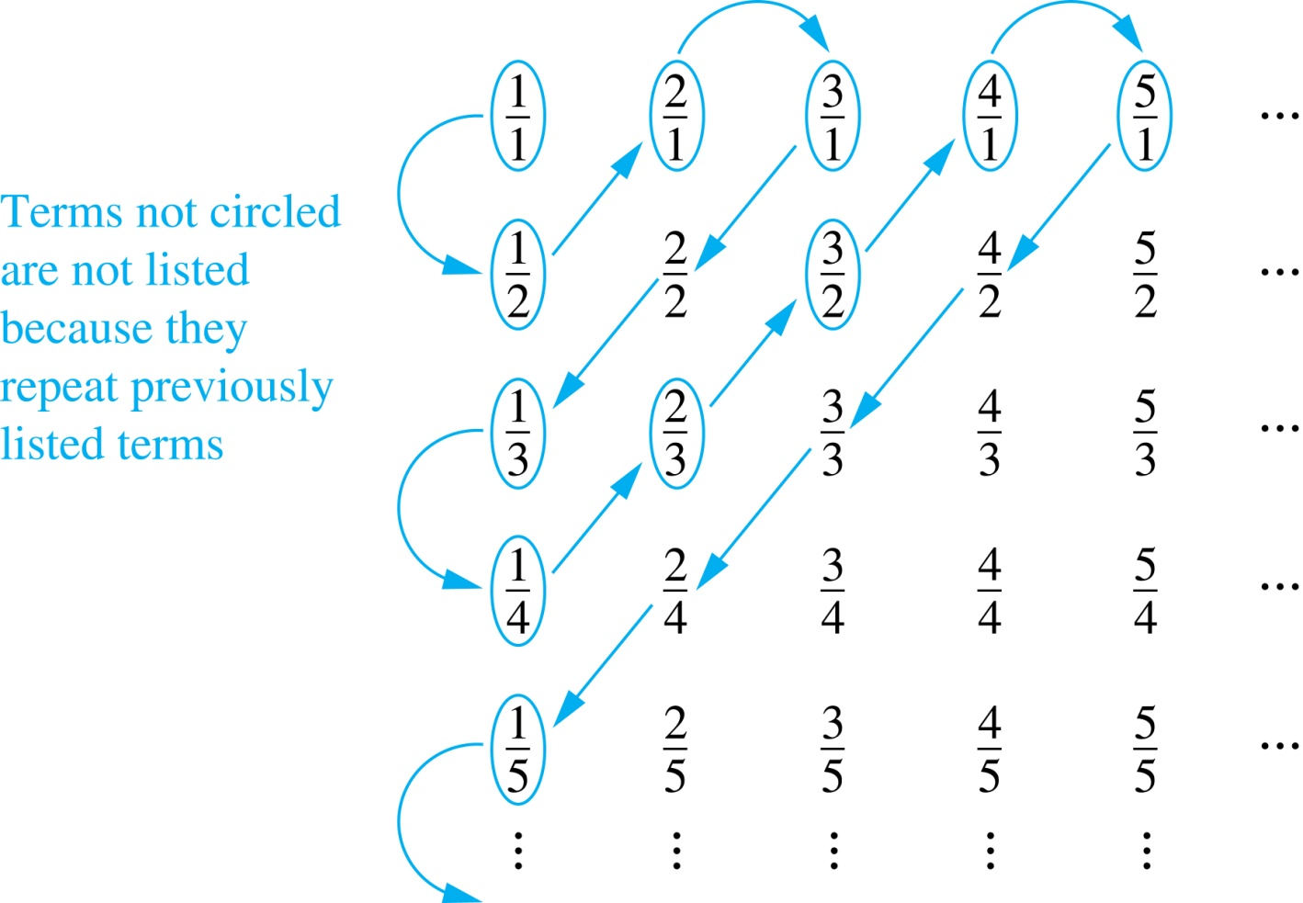
Cardinality of Sets
The Set of Rational Numbers is Countable
First row q = 1.
Second row q = 2.
etc.
Constructing the List
First list p/q with p + q = 2.
Next list p/q with p + q = 3
And so on.
1, ½, 2, 3, 1/3,1/4, 2/3, ….
Computer Science, Purdue University

Slide 9
Cardinality of Sets
Strings
Example 4: Show that the set of finite strings S over a finite alphabet A is countably infinite.
Assume an alphabetical ordering of symbols in A
Solution: Show that the strings can be listed in a sequence. First list
All the strings of length 0 in alphabetical order.
Then all the strings of length 1 in lexicographic (as in a dictionary) order.
Then all the strings of length 2 in lexicographic order.
And so on.
This implies a bijection from N to S and hence it is a countably infinite set.
Computer Science, Purdue University

Slide 10
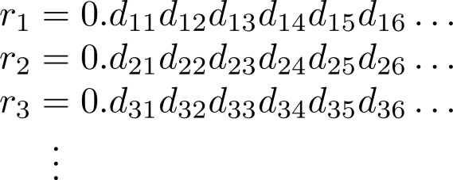
Cardinality of Sets
Set of Reals in Uncountable
Example: Show that the set of real numbers is uncountable.
Solution: The method is called the Cantor diagnalization argument, and is a proof by contradiction.
Suppose R is countable. Then the real numbers between 0 and 1 are also countable (any subset of a countable set is countable).
The real numbers between 0 and 1 can be listed in order r₁ , r₂ , r₃ ,… .
Let the decimal representation of this listing be
Computer Science, Purdue University

Slide 11
Cardinality of Sets
Set of Reals in Uncountable
Form a new real number with the decimal expansion
where
r is not equal to any of the r₁ , r₂ , r₃ ,... Because it differs from r_{i} in its ith position after the decimal point. Therefore there is a real number between 0 and 1 that is not on the list since every real number has a unique decimal expansion. Hence, all the real numbers between 0 and 1 cannot be listed, so the set of real numbers between 0 and 1 is uncountable.
Since a set with an uncountable subset is uncountable (an exercise), the set of real numbers is uncountable.
Computer Science, Purdue University

Slide 12
Thank You

